Slide 1

Event Planner
Chi Zhang

Slide 2
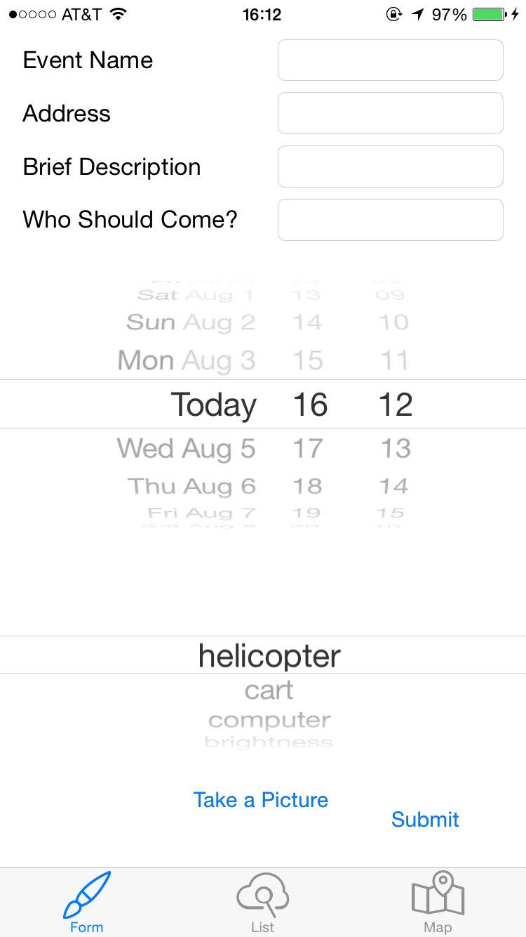
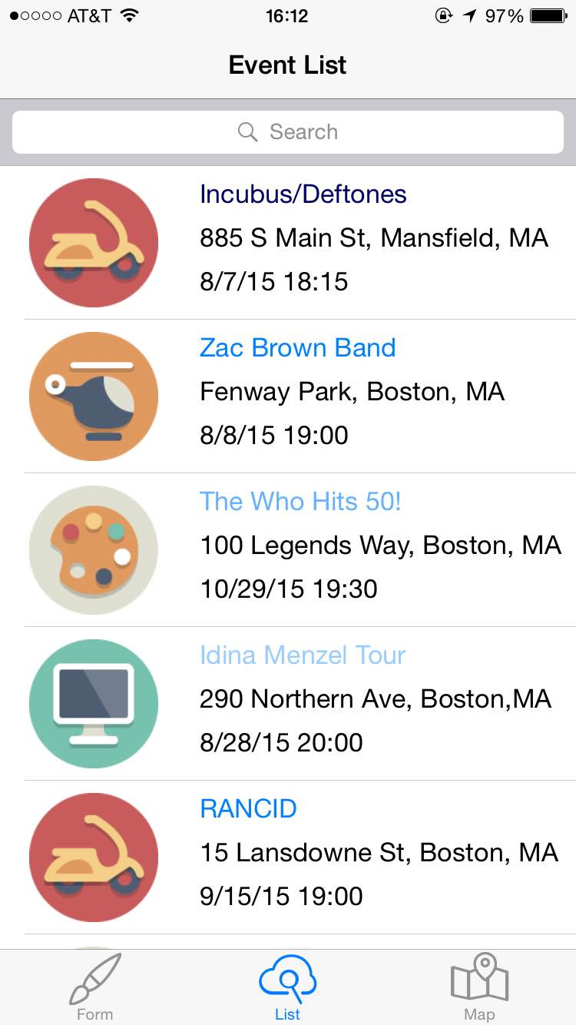
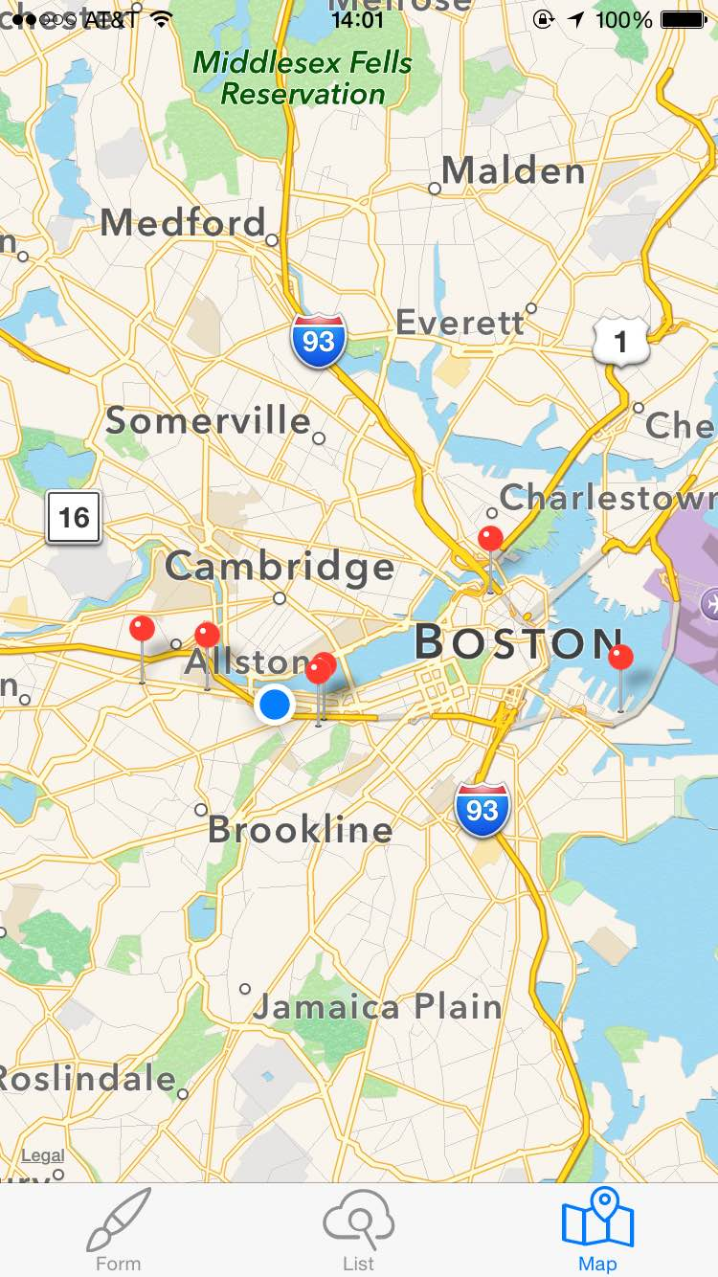
Overview

Slide 3
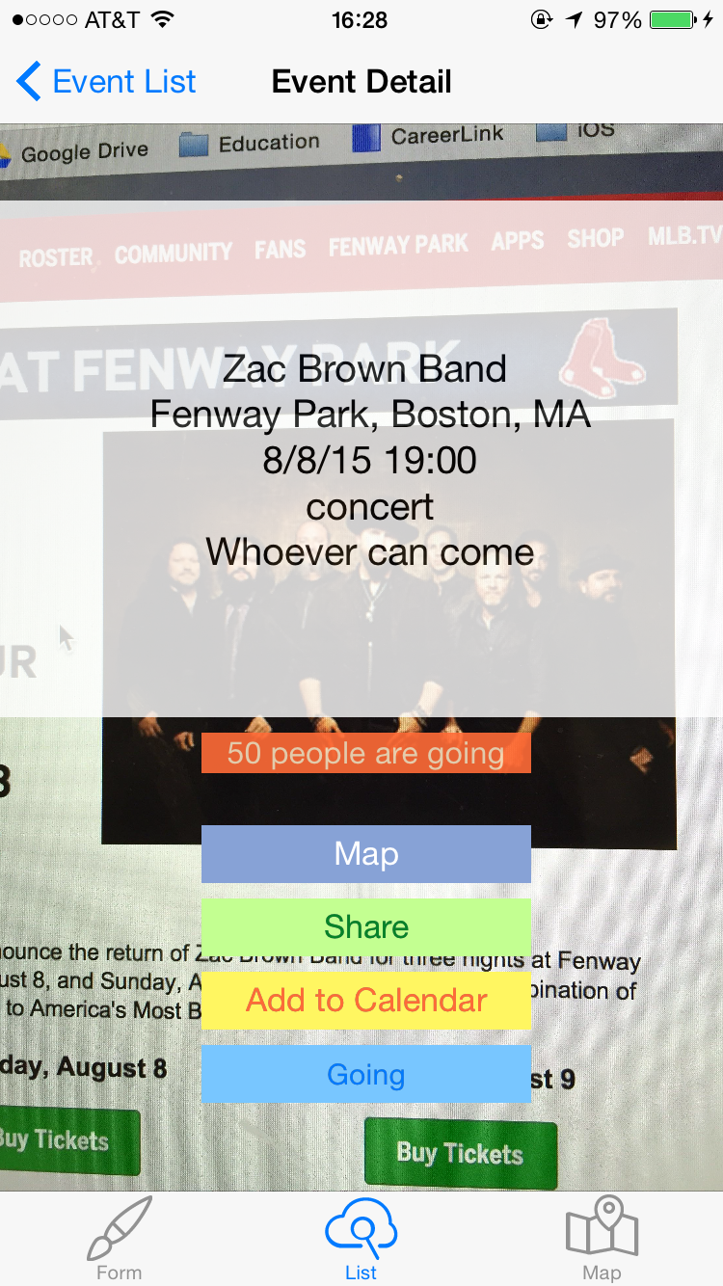
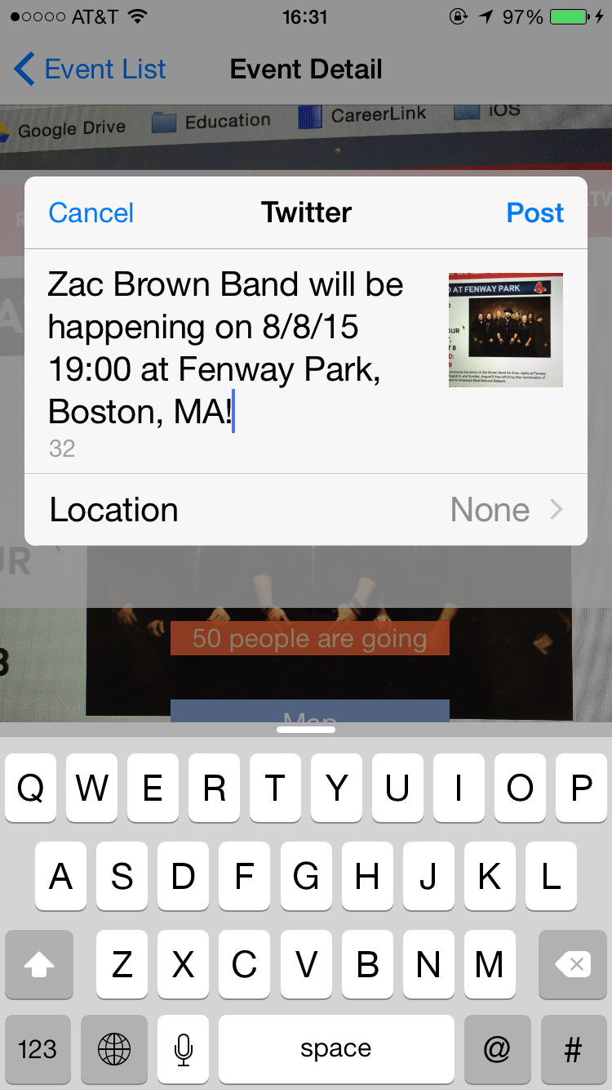
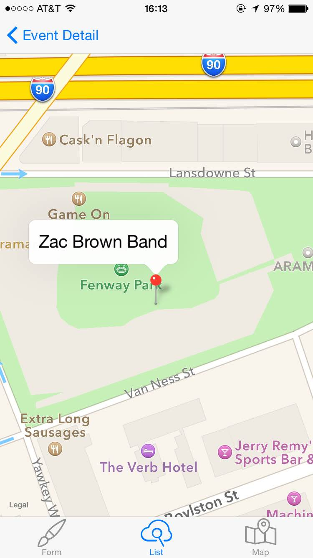
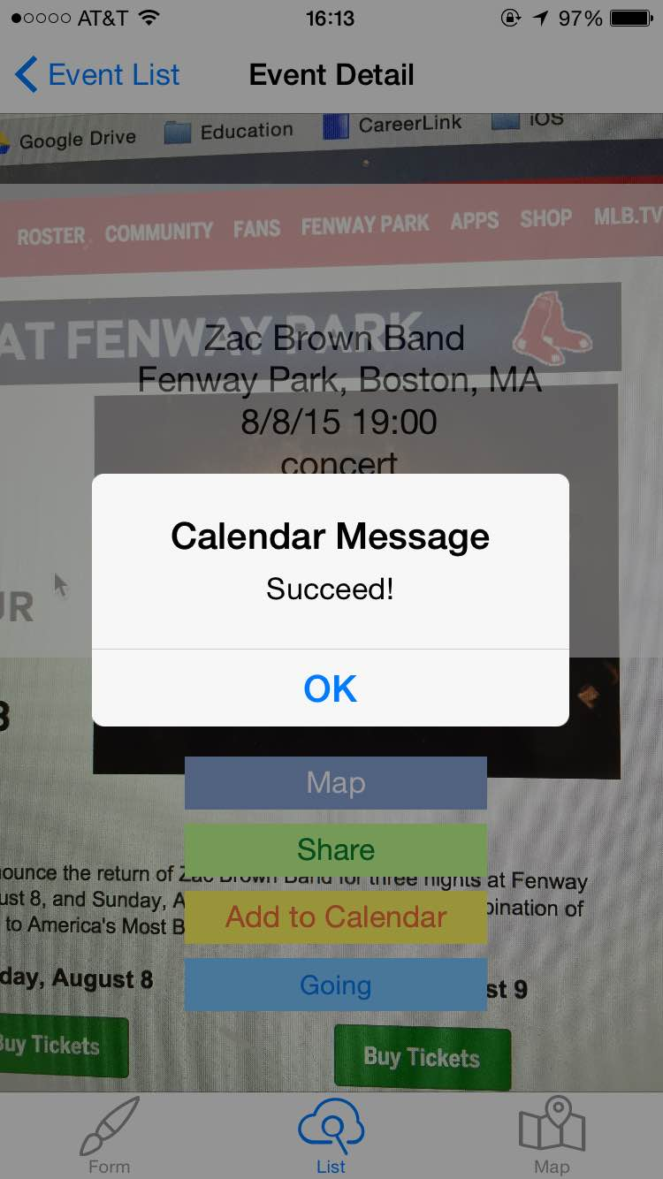
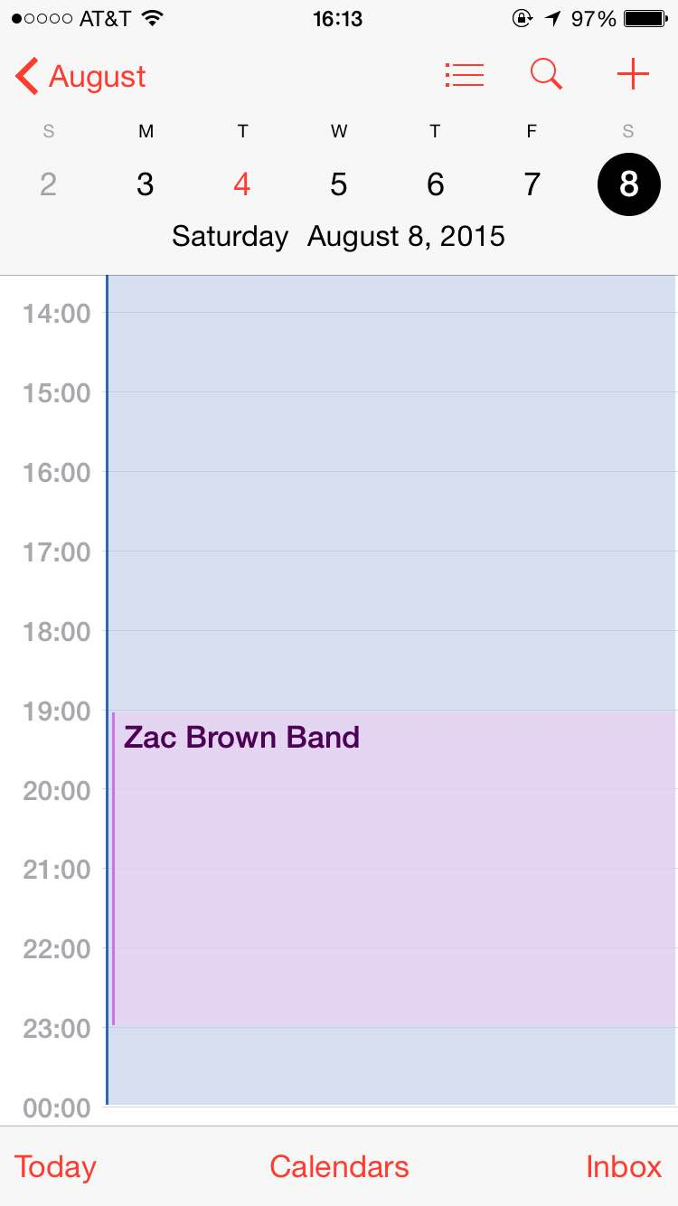

Slide 4
Tools
Parse
MapKit
CoreLocation
Social
EventKit
MobileCoreServices

Slide 5
Things to Add
Access the event detail page from the master map view
Multiple users (login, registration, etc)
More intuitive design and functionalities

Slide 6
Source & Copyright
http://andrefrommalta.com/random-number-generator-every-month-checked-authority/
https://www.youtube.com/watch?v=kkVI3njOlqU
http://www.raywenderlich.com/90971/introduction-mapkit-swift-tutorial
https://gist.github.com/mchirico/d072c4e38bda61040f91
http://shrikar.com/parse-search-in-ios-8-with-swift/
http://www.codingexplorer.com/choosing-images-with-uiimagepickercontroller-in-swift/
Appcoda: ios-swift-book & IntermediateSwift
http://www.elegantthemes.com/blog/freebie-of-the-week/beautiful-flat-icons-for-free
http://www.iconsmind.com
http://andrefrommalta.com/random-number-generator-every-month-checked-authority/

